Slide 1


Introduction to OFS
For NRTC
Your Optical Fiber Solutions Partner®
All Rights Reserved, Copyright © OFS Fitel, LLC 2017

Slide 2
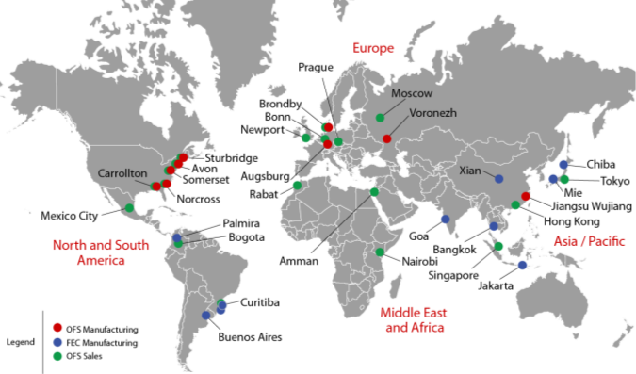
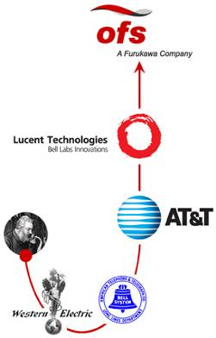

OFS – Stable, Reliable, Customer Focused
Worldwide Resources
OFS and Furukawa Global Reach

Slide 3
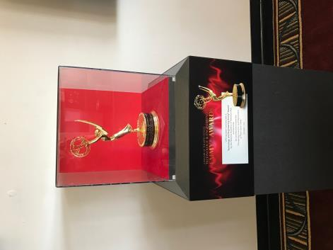
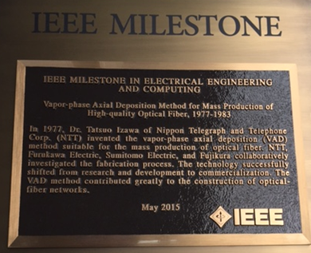
An original inventor of fiber
40+ year history in fiber technology
Technology Emmy Award winner, 2017
  “Pioneering Invention and Deployment of Fiber Optic Cable”
Fiber manufacturing method, IEEE Milestone Recipient
  <250 granted in the history of electricity
  Others include AC power, Maxwell’s equations, telephone, television, etc.
Hundreds of patents including the LC connector

Slide 4

Record of Innovations Adopted in Volume
Industry First Examples
First Commercial Optical Fiber
Bend Insensitive Singlemode Fiber
Long Haul DWDM Fiber
Full Spectrum SM Fiber
Trans Oceanic Fiber
10 Gigabit Multimode Fiber
Low and Ultra-Low PMD Fiber
Dry (Gel Free) Cable
Ribbon Cable
LC Connector
Solid Ultra-Bend Insensitive SM Fiber (EZ-Bend® Fiber)
“Invisible” In residence Fiber (InvisiLight® Solution)
Optical R&D from Bell Labs

Slide 5


Industry Stewards
OFS takes seriously its leadership role as a steward
for industry change, viability, and innovation.
Our professional memberships show the breadth of this commitment:

Slide 6
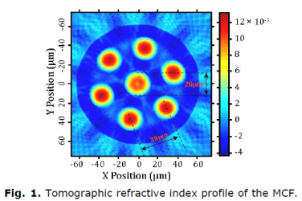
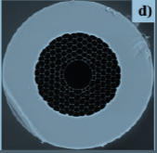
Specialty Fibers and R&D
OFS R&D finds solutions to difficult fiber problems
World leader in optical amplifier modules
Multicore fibers for increased bandwidth density
Hollow core fiber for ultra low latency applications
What problems can we help you solve?
SEM Photo of hollow core fiber

Slide 7

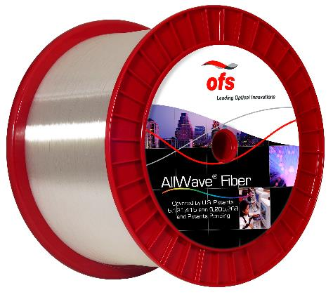
OFS Fiber – The fiber is the network™
Made in Norcross, GA
Zero Water Peak (ZWP)
100% synthetic silica
Leading fiber portfolio
Completely compatible
Notes:
Shelves Large Combiner Units or LCU (19”, 23”)
AllWave Flex+ Jumpers
AccuPack Cable
Optical Cable Entrance or OCE Shelves
M-Pack Cordage
WDM Access Modules
NOTE: If an item needs to be removed then we can remove Access Modules.
MISSING MULTIFBER CABLE ASSEMBLY. SHOULD ADD THIS IN.

Slide 8
Choices and guidance
to build the most suitable network for your organization

Slide 9
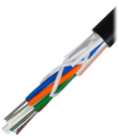
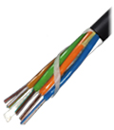
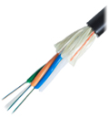
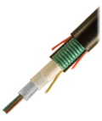
Feeder and Distribution
Aerial or underground
Light and easy handling
Rugged and reliable
More fibers in less space
Fortex™
Loose Tube Cables
MiDia®
Microcables
PowerGuide®
ADSS Cables
AccuRibbon AccuRoll®
Ribbon and RR Cables

Slide 10

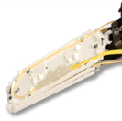
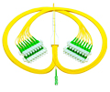
Splitters
MPO Splitter Module
Distributed
Easy provisioning
Ruggedized
PLC Splitter
Direct Connect
PLC Splitter

Slide 11
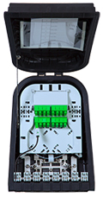
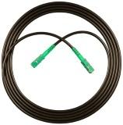
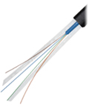
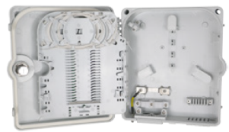
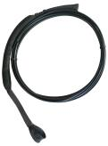
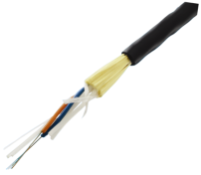
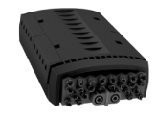
Drop Solutions – Terminals and cables
Plug and play or spliced
Ruggedized
Integrated drop/splitter
Indoor / outdoor options
Mini LT Drop
Cable
12 fiber indoor/outdoor SlimBox
EZ-Bend® Cable
SlimBox™
Aerial and Underground
Drop Terminals
EZ-Bend® Toneable
PowerGuide TTH Cable

Slide 12
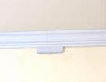
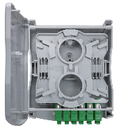
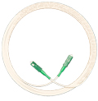
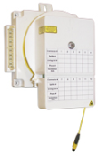
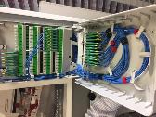
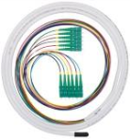
Building Distribution
Small footprint
Plug and play
Easy installation
Indoor / outdoor options
InvisiLight MDU and Facade Systems
SlimBox®
Enclosures
EZ-Bend®
SlimBox®
64 FDH
V-Linx™
Spool & Play
HomeRun

Slide 13


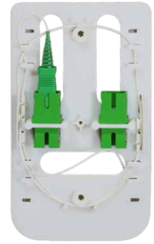
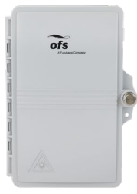
In Home and Apartment
Plug and play
Small footprint
Fast clean installation
InvisiLight® ILU Solution
SlimBox™
CSP Module
EZ-Bend®
2 Fiber SlimBox™
SlimBox Wall plate

Slide 14





Fibers for all applications
Transoceanic
Transcontinental/
Long Haul
Regional
Metro
Fiber to the Subscriber (FTTx)

Slide 15
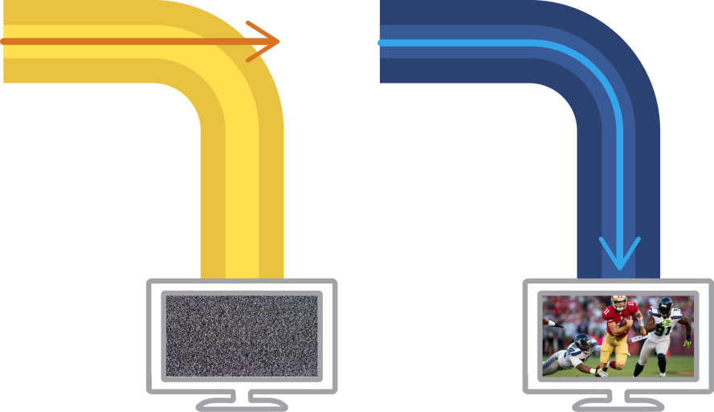


Fiber types
Conventional
Single-mode Fiber
Bend Insensitive
Single-mode Fiber
Single-mode Fiber
Carries only one mode of light
Used for FTTH
(small radius)
(small radius)
Multimode Fiber
Carries multiple modes of light
Not typically used in FTTH
SERVICE DISRUPTED
SERVICE MAINTAINED

Slide 16

Optical spectrum needed for the future
ITU-T Wavelength Bands (nm) – G.694.2
Technology
P2P & DWDM
12 ch CWDM
Year
1990s
1260 1280 1300 1320 1340 1360 1380 1400 1420 1440 1460 1480 1500 1520 1540 1560 1580 1600 1620
2000s
GE/GPON
RFoG
E-Band CWDM
2010
10GPON
2012
NG-PON2
(40G-PON)
2016
10 mm radius
Water peak loss
Bending Loss
Std SMF G.652.D
Full Spectrum?
The first 30 years used 1310/1550 nm.
The next 30 will require the entire ITU spectrum.

Slide 17
Zero Water Peak Performance
Clean performance through the optical spectrum
O
E
S
C
L
U
1.2
wavelength (nm)
0.9
Conventional SM Fiber
G.652A/B
Loss (dB/km)
0.6
LWP fiber
0.3
Zero Water Peak fiber - lowest loss
0
1300
1400
1500
1600
ZWP has up to 22% lower attenuation in the water peak region

Slide 18
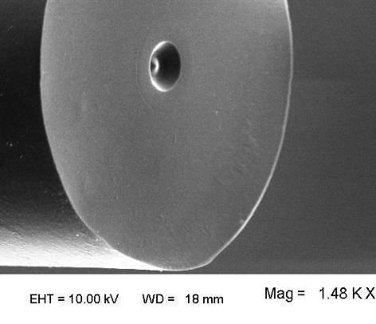
High Purity Synthetic Silica VS. Natural Quartz
OFS Advantage:
Glass Material | 100% pure synthetic silica | ✓
Figure 2. Cheap natural quartz raw material fiber clearly shows many pits and imperfections .
“Acne like” condition shows difference between pure and clean synthetic quartz vs natural quartz with its impurities and inclusions.
Figure 1. High purity synthetic silica fiber
Figures 1 and 2 show SEM micrographs of fiber end-faces. In both cases the cleaved fiber surface was briefly etched in acid (48% HF for 3 minutes).

Slide 19



AllWave®+ and AllWave One Fibers
The next generations of single mode fiber
15% lower loss for up to 15% longer reach
Even lower bend loss
(30% lower than AllWave + fiber)
G.657.A1bend loss
33% better PMD LDV (0.04)
10 mm min bend radius
Full Spectrum
Zero Water Peak
9.2 MFD for seamless splicing and testing
100% Synthetic Silica
Pure Reliable Glass
16 mm min bend radius
13% -33% lower loss than G.652.D
G.652.D

Slide 20

AllWave®+ Fiber value
Parameter | Desired |  | Value
Optical Spectrum | 100% ZWP, 5 wavelengths specified In-cable | ✓ | Longer reach
Bending Performance | AllWave+ Fiber G.657A1 9.2 micron MFD | ✓ | Less bend sensitive
PMD | Extensive in-cable performance and specification | ✓ | Higher data rates
Glass Material | 100% pure synthetic silica | ✓ | Reliability
Mechanical Reliability | Dynamic fatigue performance. Excellent coating reliability | ✓ | Reliability

Slide 21
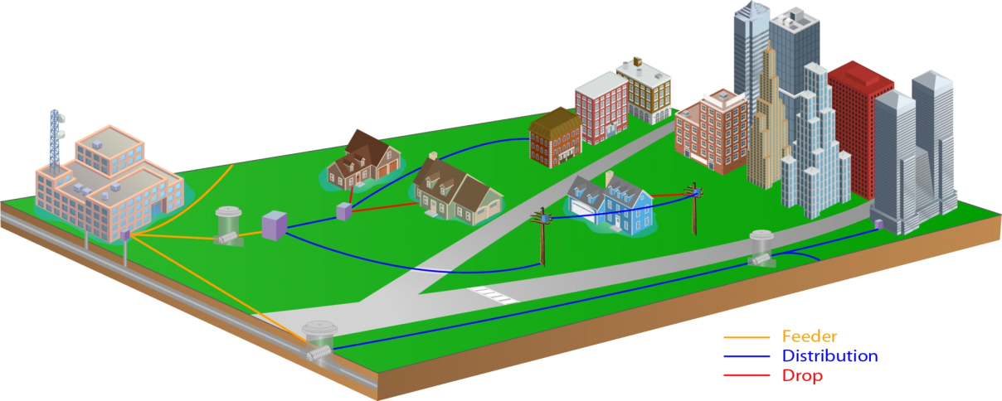
FTTH Network Macro View
Central Office /
Drop
Drop
Headend
Closures or
Cable
Terminals
Splitter
Cabinet
Underground
Aerial
Cable
Splice
Direct Buried
Cable
Closures
Cable

Slide 22
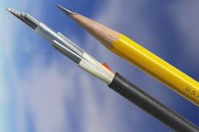

Outside Plant Fiber Cable
Most often “loose tube” cable structure
  Fibers loose in buffer tubes
    Handles stress/strain and temperature fluctuations and climatic extremes
  Also available in ribbons
  Fibers and buffers are color coded
Underground applications
  Direct buried or in duct
Aerial applications
  Lashed or self-supporting (ADSS)
Buffer tube
Fiber
Loose buffer tube structure
Ribbon fiber and cable structure
Notes:
The majority of cables are loose tubes, where the fibers are loose in individual buffer tubes. The buffer tubes help to protect the fibers from stresses and strains caused by environmental or other deployment conditions. The fibers float freely in the tubes., and there is excess fiber length in the tubes to enable the cable to stretch without placing strain on the fibers. The tubes and fibers have a different coefficient of thermal expansion so the free floating fibers are isolated from the effects of hot and cold temperature.
Ribbons are also placed in tubes with some extra length.
The fibers and buffer tubes are individually color coded so the service provider can tell them apart. It’s critical that fibers are spliced together properly to form a continuous network, and the fiber and buffer tube colors are used to match the like fibers together.
As we mentioned earlier, underground cables that are direct buried are typically armored to provide some protection against damage from rodents. However, no cable type is immune from damage from rodents. Armored cables need to be grounded to protect against the network against lightning strikes. Cables that are placed in ducts are typically dielectric, meaning that they contain no metal.
Finally, duct cables can be lashed to a messenger for aerial applications, or can be self-supporting. We’ll talk about these cables in more detail later.

Slide 23
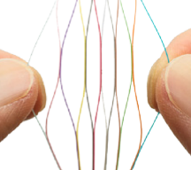
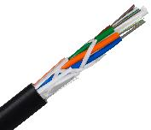
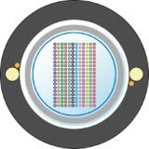

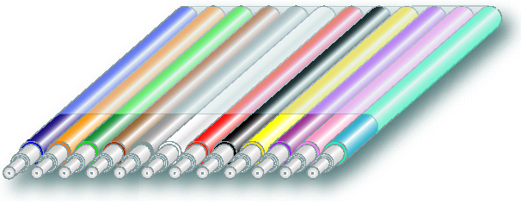
How to choose?
Fiber structure
Loose tube and micro
Rollable ribbon
Flat ribbon
Cable structure
Central tube
Stranded

Slide 24
Choose by fiber count and application
Loose tube
Ribbon
96
144
288
432
864
1728
Fiber count

Slide 25

OFS Loose Tube Cable Lineup
Fortex DT
250 µm, 12F/tube
GR-20
Fortex 2DT
200 µm, 12F/tube
GR-20
Price
Approved for lashing
MiDia FX
250 µm, 12F/tube
GR-20 Spec. Apps
1.05
MiDia GX
250 µm, 12F/tube
MiDia 2FX/2GX
200 µm fiber, 24F/tube
1
Fortex DT
Fortex 2DT
MiDia FX
MiDia GX
MiDia 2FX/2GX
25

Slide 26
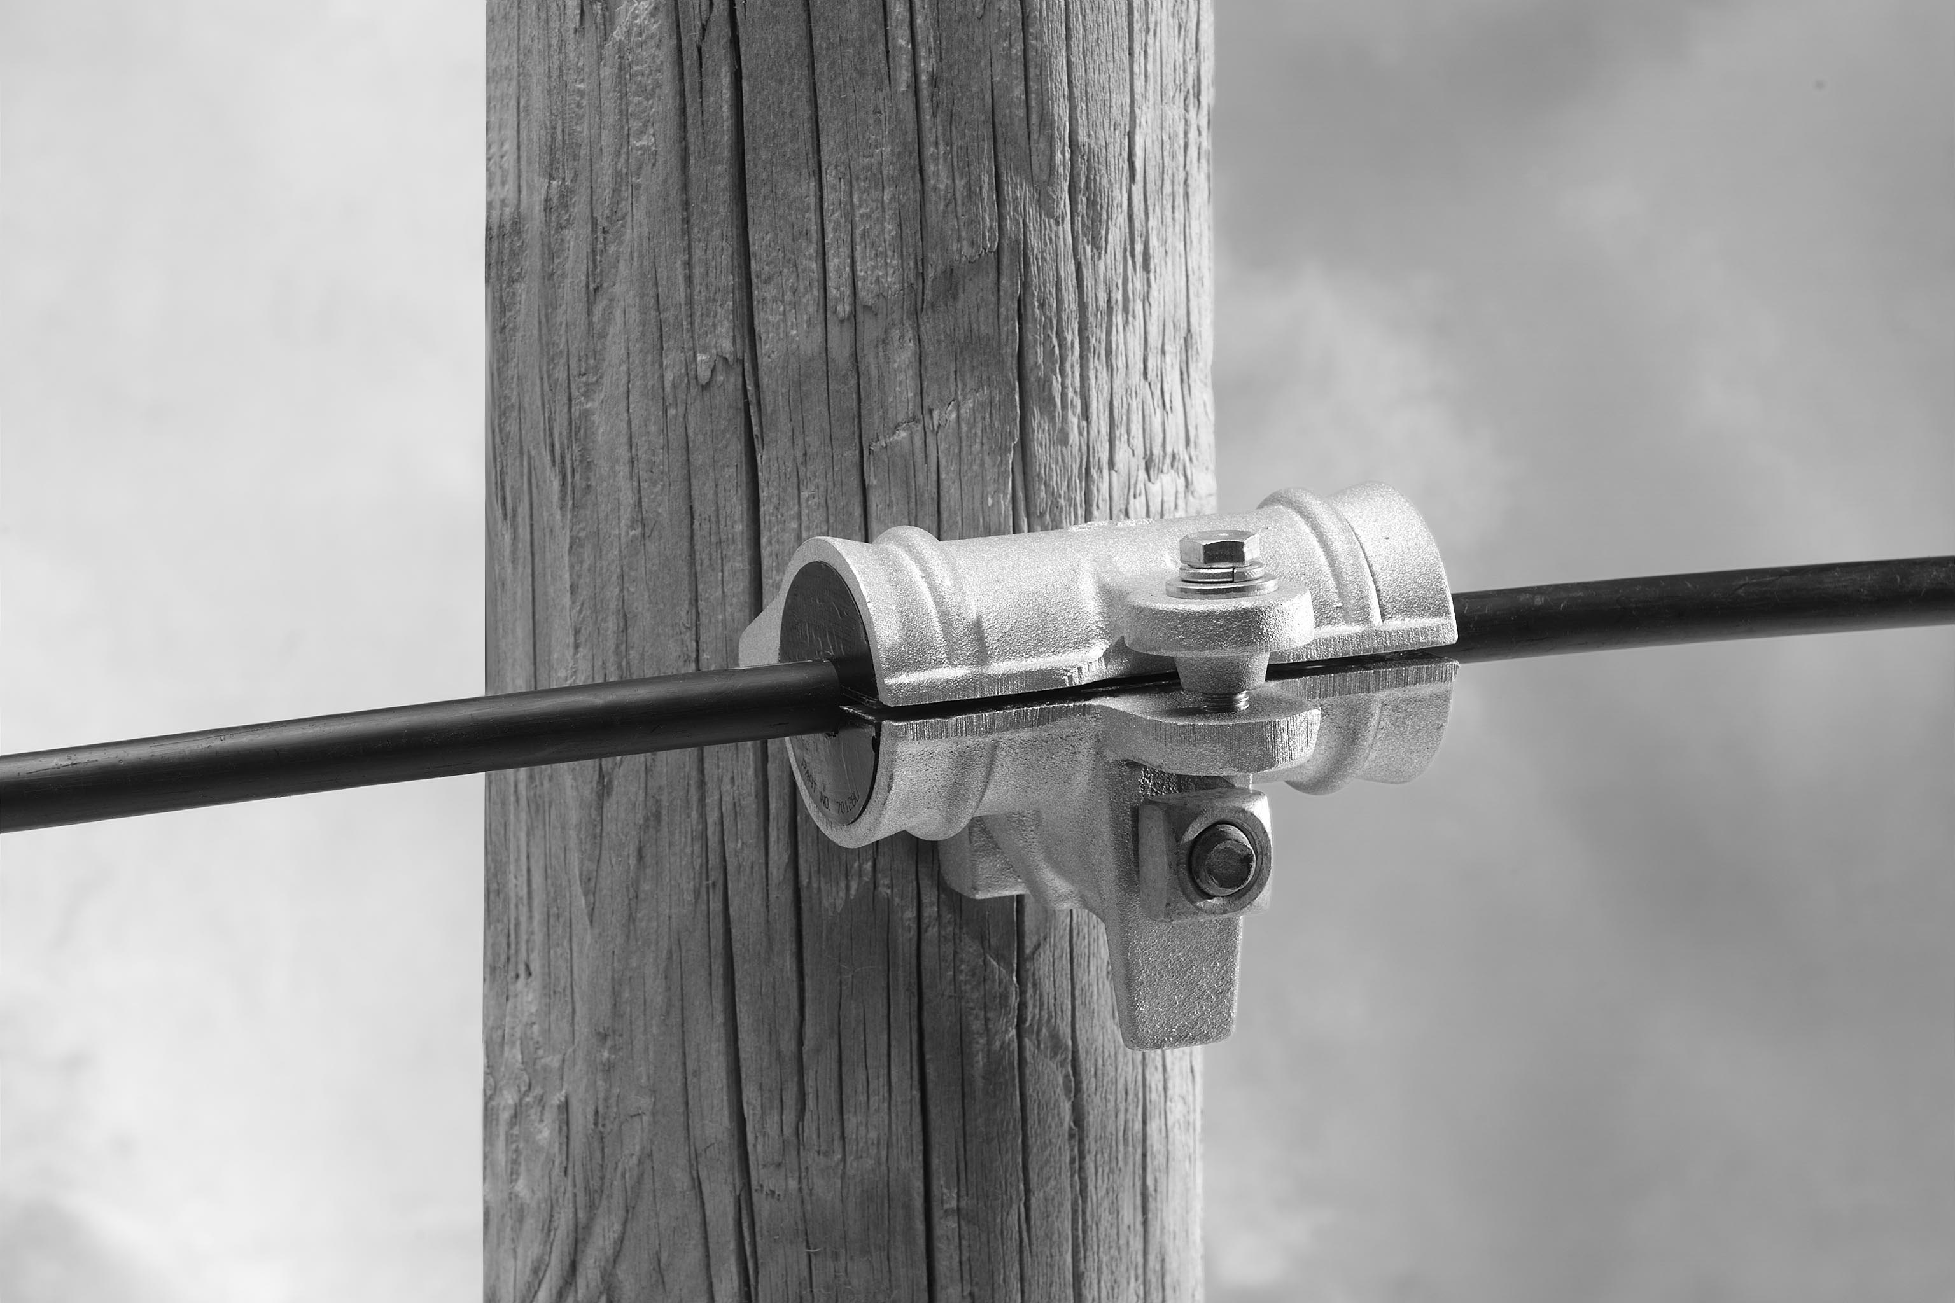
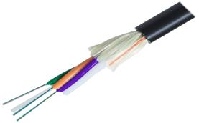

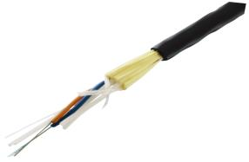

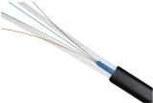

Typical OFS ADSS options
Main trunk cables and ultra-long drops
  PowerGuide DT, Gel-Free ADSS
  Lite tension formed wire deadends and tangent clamps
Branch and longer span drop cables
  PowerGuide TTH “To the home”, 9.0 mm
  Up to 300-400’ spans, dependent upon sag/tension/loading
  PLP 2888 series deadends for shorter spans
  Lite tension deadends for longer spans
Shorter drops
  Mini LT flat drop
  Roughly 250’ spans, dependent upon sag/tension/loading
  Uses very inexpensive wedge clamp

Slide 27
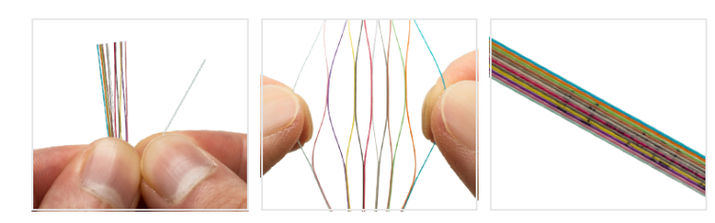
Flat and rollable ribbons
What is a ribbon?
  Individual fibers bonded together by a matrix material
Advantages of ribbons
  Fiber preparation and splicing
  Restoration times
Suitable in all general OSP applications including
    Underground/duct
    Aerial/lashed, ADSS
    Direct Buried
Primary cable type deployed by many telecom companies

Slide 28
Significant reduction in splicing time/costs
Breakeven point typically 96-216 fibers
Splice 12 fibers versus 1
Less downtime for emergency restoration
Possible scenario – ribbon for backbone, loose tube for distribution cables

Slide 29
Rollable ribbons as distribution cables
Distribution cables traditionally have been loose tube
Rollable ribbons have advantages for distribution cables
  Easier to pick out fibers
  Can use ribbon splicing as appropriate
  Smaller diameters/weights than flat ribbon cables
More expensive for lower fiber counts
Early days, but watch this space!

Slide 30
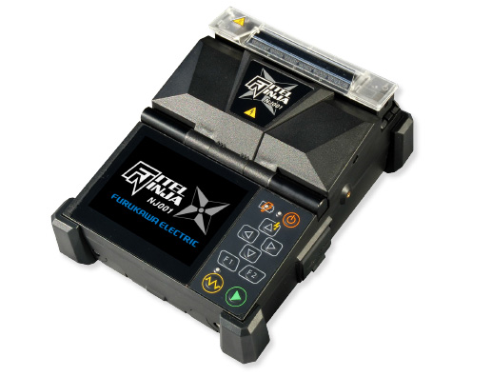
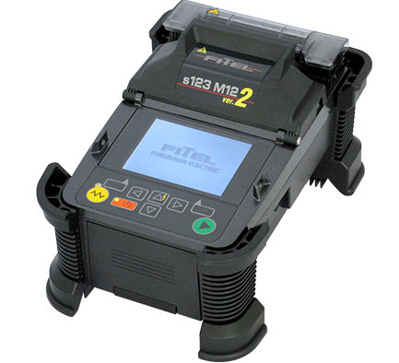
Fusion splicers
Complete line of fusion splicers
  Profile alignment
  Cladding alignment
  Fixed V-groove
  Ribbon/RR
Field proven, rugged, reliable, cost effective

Slide 31
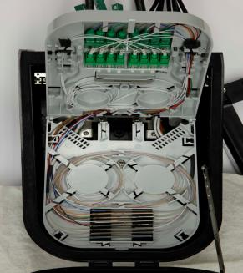
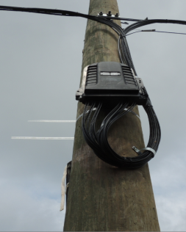
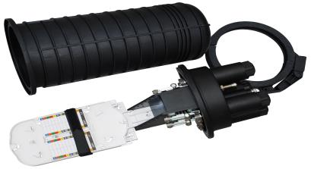
Terminals and closures
SlimBox Drop Terminal
  Spliced or pre-connectorized drops
  Holds splitters
  Designed specifically for ADSS drop applications
  Cost effective
Standard fiber optic closure
  For longer span applications

Slide 32
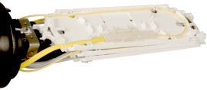
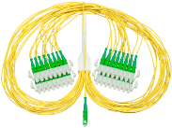
Splitters for distributed split architectures
Multiple choices – typical split ratios
  Spliced or pre-connectorized
  “DirectConnect”
  “Ruggedized”
  “Packaged”
Ruggedized splitter in a splice tray
1 x 32
Direct Connect Splitter

Slide 33
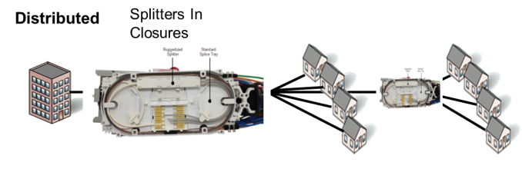
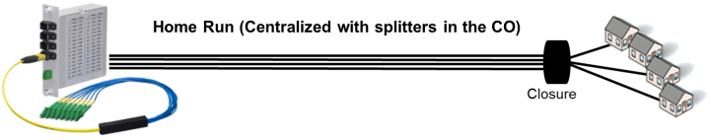





Where to place the splitter – 4 main options
Lower subscription rates
Higher subscription rates
1x16 or 1x32 splitters in closures
Higher OLT costs
Significant decrease in fiber count
Uses more fibers and splicing
Useful for networks <1km (3-4kft) from the CO
Centralized splits
Distributed
Cascaded
Splitters In Closures
Also sometimes called “optical taps”
Useful for networks with lower subscription rates
Uses higher fiber counts
1x4/1x8 splitters in closures
Higher OLT costs
Significant decrease in fiber count
Often used in rural environments
Other versions include uneven power splitters

Slide 34

Distributed tap design and troubleshooting
Hypothetical 1x32 splitter OTDR trace
Troubleshooting with tap ports can be difficult
  Excellent recordkeeping needed to resolve planned versus unplanned losses
How do you plan inventory for the variety of taps needed?
1x32 splitter
Final splice to home
0.4 dB
0.6
Hypothetical “distributed tap” OTDR trace
0.8
1.06
1.69
2.32
Final splice to home
Actual “distributed tap”/unbalanced split trace

Slide 35

Distributed splits vs distributed taps – costs
Distributed taps are typically more expensive
  Larger, more expensive closures
  Taps themselves are more expensive
Distributed split sweet spot – 1x2 and 1x16
  Smaller number of splitters
  Can use re-use 12 fiber cables
Other split ratios
  1x32 – Can be less expensive in more densely populated areas
    Partially offset by need for 24 fiber cable to reuse fibers
  1x4/1x8 (and vice versa)
    Can re-use 12 fiber cables
    Increases splitter number, which increases cost

Slide 36
Distributed balanced split versus unbalanced split
Add restoration time/cost…Will cost more to support?
 | Distributed cascaded split | “Distributed tap”
Cost | Less expensive by up to 30% | More expensive driven by taps and larger closures needed
Spending rate | Lower at the start | Higher at the start
Fiber use | Similar – low fiber counts can be used Fiber colors re-used after the splitter | Similar – low fiber counts can be used “Taps” off of one base fiber
Optical performance | PON was designed to use splitters. No significant issues here. | A little more challenging to plan optical tap losses. Manageable.
Ease of troubleshooting | Easier. Main challenge is not significant…OTDR through a splitter from the home side | Harder…How do you determine where a problem is when there are so many different designed losses in the network?
Inventory management | Easier. Standard splitter inventory needed. | Harder. How do you plan for the appropriate tap/attenuation combination?
Ease of expansion | Easier | Existing customers get an outage if a new tap is added to the network
Material availability | More sources | Fewer sources
OFS position on distributed tap – it can be useful in certain situations, but we view it as an alternative tool to be used when other methods are inadequate, not as a primary design tool.

Slide 37


Drop cable options
Mini LT or TB
Flat drop – with or without toning wire
Drop cables can be pre-connectorized
One-end, 2 ends, or bare
Mini C2
round drop - armored
EZ Bend – with or without toning wire

Slide 38

Pre-connectorized or not
Pros
  Reduces labor costs
    Faster installation
    Lower skill requirements
  No up front capital tool requirements
Cons
  Inventory management if using pre-terminating both ends
  Slack management if terminating both ends
  Scrap if terminating one end
Many OFS customer pre-connectorize one end and splice the other

Slide 39


Hardened vs non-hardened connectors
If you want the convenience of connectors…
Why hardened? More expensive, no improved performance
Up front costs more expensive
Additional hidden costs
  Inventory costs
  Warehouse space
  Engineering costs
Limited availability
More detailed information available
Non-hardened connectors are a better choice
  Much less expensive than hardened connectors
  Easier to clean
  More reliable
Two choices
  Factory pre-connectorized cables
    One-end only is most efficient
  Fusion-splice on connectors

Slide 40


Connectorization methods
Pigtail splicing’
Mechanical fusion splice-on connectors
Fusion splice-on connectors – EZ Fuse

Slide 41




To and in the home
SlimBox CSP or 2 fiber boxes
InvisiLight ILU Solution
EZ Bend Drop Cables
SlimBox Wall Plate

Slide 42


Typical Home ONT Installation Location
Typical ONT recommendation - high and central location in the home
May require “wrapping” the house to find best entry point
3 in-home pathways
  Crawl space
  Attic
  Living space level
Typical installations require tight bend capability
OSP Drop

Slide 43
Bend loss vs wavelength and radius
Optical Fiber Bending Loss Increase vs Wavelength
Macro-bending Loss of typical standard G.652D SMF
Single 360 degree turn (maximum loss)
20
15
10 mm radius
std SMF
Macrobending Loss (dB)
7.5 mm radius
10
std SMF
5
5 mm radius
std SMF
0
1260
1280
1300
1320
1340
1360
1380
1400
1420
1440
1460
1480
1500
1520
1540
1560
1580
1600
1620
Wavelength (nm)
Bending loss of Std SMF (G.652D) can disrupt services or reduce reach

Slide 44
Bending Loss will become an even Bigger Challenge
Application | Standard | Current Generation |  | Next Generation on Same Fiber Network |  | Bending Loss Increase
FTTH | IEEE | GE-PON downstream | 1490 nm | 10G E-PON downstream | 1577 nm | 3X
 | ITU-T | G-PON Downstream |  | 10G-PON downstream
 |  |  |  | 40G-PON (NG-PON2) | 1603 nm | 4X
DOCSIS and HFC | SCTE /ITU | RF-Video downstream | 1550 nm | RFoG upstream | 1610 nm | 2X
Metro and some Long Haul | ITU | C-Band DWDM /CWDM | 1560 nm | L-Band DWDM /CWDM | 1625 nm | 2.5X

Slide 45
ITU-T G.657 Bend Loss Insensitive SM Fiber
ITU-T G.657 Minimum design radius | G.652D Compliant Long reach and most short reach needs | G.652D Compatible Short reach (<1 KM) with sharp bending (MDUs, In residence)
10 mm Bend Challenged OSP Cable | G.657A1 | NOT A STANDARD
7.5 mm Most Connectivity Applications | G.657A2 | G.657B2 (Obsolete)
5.0 mm In Home/MDU Drop | NOT A STANDARD | G.657B3

Slide 46




EZ-Bend® Fiber has changed the game for SFU and MDU Deployment
EZ-Bend® Cord
InvisiLight® Solutions
2.5 mm bend radius can handle any corner and many corners
OFS Labs Original Innovation – (Resonance Assisted Fiber)

Slide 47

What makes Bend Insensitive Fiber special?
Standard Single-mode fiber
Allows light to leak out during bending
Bend insensitive fiber
More complex profile captures light
Representative index of refraction profiles (not exact)

Slide 48





If needed - Wrapping the house – EZ Bend 3.0 or 4.8
Attach to side of house with cable clips
OSP Drop
Run along soffit
Fit under vinyl siding grooves and along downspouts

Slide 49


Wall or SWE Mounted ONT – Bracket fits on top
EZ hide module cover to be removed
InvisiLight option
  Bracket placed on top of InvisiLight EZ Hide module with utility box
EZ Bend option
  Wall fish to utility box
  Calix bracket placed on utility box
  Run EZ Bend into ONT
Utility box screw locations on Calix wall-mount bracket

Slide 50



Desk or tabletop mount
InvisiLight options
  Standard module – Jumper to ONT
  80x80 module – Jumper to ONT
  EZ Connect module – no jumper needed
EZ Bend option
  SlimBox Wall Plate
    With or without utility box
    Jumper to ONT
80x80
module
Standard module
EZ Connect module
SlimBox wall plate

Slide 51


For short distance in-home options
For smaller homes or if the ONT goes on an outer wall
InvisiLight
  Standard module – Jumper to ONT
  80x80 module – Jumper to ONT
  EZ Connect module – no jumper needed
EZ Bend Drop Solution
  Option to strip off EZ Bend jacket to reveal InvisiLight cord
  Run into ONT
OSP Drop

Slide 52






Putting it all together
Fortex DT
SlimBox Drop Terminal and splitter
PowerGuide TTH, Mini LT, and hardware
SlimBox CSP and EZ Bend to the ONT

Slide 53




Fast, Easy, Virtually Invisible MDU Fiber Now Possible
In Living Units In Hallways On Buildings
16 Fibers
Single Fiber
24 Fibers
…..and around corners
2.5 mm bend radius fiber

Slide 54




InvisiLight® Optical Solutions
InvisiLight ILU Solution
InvisiLight MDU Solution
InvisiLight Drop Solution
InvisiLight Façade Solution
Launched 2012
1 fiber for inside the living unit to the ONT
Launched 2015
12 fibers for
hallways and risers
Launched 2016
Various drop cables, easily stripped down to
1 InvisiLight fiber inside
Launched 2017
12 or 24 fibers in compact virtually invisible cables

Slide 55



InvisiLight® MDU Solution for hallways and risers
Conventional Hallway Fiber
InvisiLight MDU Solution
Molding
InvisiLight
12 fiber cord
Very visible
Disrupts Décor
Slow installation
Virtually invisible
Preferred by building owners
Faster and easier to install
Cost effective

Slide 56
Pre and Post Sales Support
Sales
  Inside and outside
Solutions Engineering
  Inside and outside
Field Services
Professional services (as appropriate)

Slide 57
Choices and guidance
to build the most suitable network for your organization

Slide 58

Questions?
Mark Boxer
Applications Engineering Manager
OFS
mboxer@ofsoptics.com
252 495-4131

